Slide 1

DESIGN AND SIMULATION OF CONTROLLERS FOR STANDALONE AND GRID CONNECTED SOLAR PV SYSTEM
Presented by
Gaurav Mishra
202118114
Under the Guidance of
Dr. Archana Soni
(Associate Professor)
Energy Centre

Slide 2
Table of Content
Introduction
Literature Review and Research Gap
Objective and Methodology
Tunning method
Designing of Boost Converter
Software and Simulation
Result
Conclusion and Future Scope
Reference

Slide 3
Introduction
Solar photovoltaic (PV) system made a great attention in the electrical power generation due to its advantages.
This dissertation contains the design, simulation and analysis of the PV system with DC – DC Boost converter controlled by different controllers and the study of various protection scheme of grid connected solar PV system.
The project contains the comparative study of the with and without controlled mechanism used in the feedback of the PV system with DC – DC boost converter.
And also compare the different controllers (like PI, PID used as control mechanism) output when controllers are tuned by using tuning mechanism called as Ziegler – Nichol’s method (for optimize the output of the controllers) and untuned.
The output of the DC – DC boost converter enhance by using the MPPT algorithm.
The Boost converter model’s simulation done by using MATLAB/SIMULINK software demonstrate that controllers can improve the feedback system’s steady state and transient response, also enhance the system output and efficiency.

Slide 4
Literature Review
Author Name | Summary of Paper | Year of Publication
Ahmed T. Mohamed a, Mahmoud F. Mahmoud a, R.A. Swief b,⇑, Lobna A. Said a, Ahmed G. Radwan | This paper aims a design and analysis for the PV system with a DC – DC Boost converter controlled by different controllers. First objective is to search a five parameters model based on the data sheet. Second part, a detail comparison between without and with P,PI, PID controller. Different tunning algorithm used like flower pollination algorithm (FPA) and Water cycle algorithm (WCA) and also compare their results. | 2021
Norazlan Hashim1, Zainal Salam2, Dalina Johari3, Nik Fasdi Nik Ismail4 | This paper deals with designing of DC-DC Boost converter parameter like L,C and R. Its gives about the controlling of duty cycle of DC-DC converter by extracting maximum power from the PV module. it also consist algorithm of MPPT charge controller. | 2018

Slide 5
Name of Author | Summary of Paper | Year of publication
Djaafar Toumi b, Djiliani Benattous b, Ahmed Ibrahim a,∗, H.I. Abdul-Ghaffar c, Sergey Obukhov d, Raef Aboelsaud a, Yacine Labbi b, Ahmed A. Zaki Diab e | This paper propose the block diagram of the construction of autonomous PV system. The simulation of DC-DC converter using MATLAB/SIMULINK package. It also consist the efficient way of power conversion using MPPT. | 2021
Laurentiu Faraa et al. | This paper which explains the necessity of stand alone system in difficult terrain. Mathematical modelling stand-alone PV system. Simulation of standalone pv system done by MATLAB. | 2017

Slide 6
Research Gap
It is realized after reviewing the various research papers that there is less research done on the
Different configuration of controllers used to enhance the power output from the Solar PV system.
And comparative study of performance parameters after using the controller.
Also, performance analysis of different controller configuration for different type of Irradiances i.e. for cloudy and sunny days irradiance.

Slide 7
OBJECTIVES
Design the parameters of Boost Converter.
Simulation of Boost converter with different Controllers using MATLAB Software.
Comparative study of different configuration of controllers.
Study of protection schemes for Grid connected solar PV System.

Slide 8
METHODOLOGY
These are the following steps which author follow:
Collection of data i.e., rating of components of system.
Calculation of the parameters of the DC – DC converter.
Simulation of the MPPT Charge Controller.
Simulation of converter without MPPT algorithm using MATLAB.
Simulation of converter with MPPT algorithm using MATLAB.
Simulation of converter with MPPT Charge Controller and PI controller and
Tunning of PI controller using the Ziegler Nichols Algorithm.
Simulation of converter with MPPT Charge Controller and PID controller using MATLAB.
Tunning of PID controller using the Ziegler Nichols Algorithm
Comparative study of results of different controller on the basis of different Irradiance and with & without tunning of Controllers.
Calculation of performance parameters.
Study of Various protection system used in power system.

Slide 9
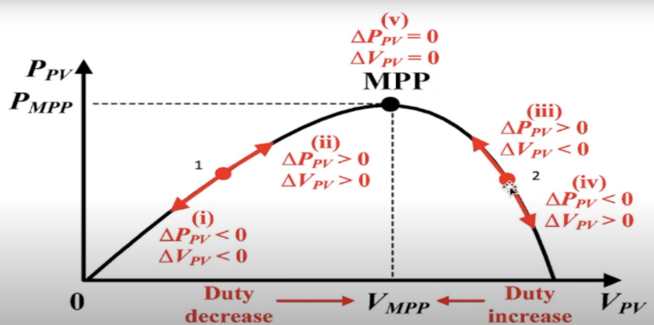
MPPT Charge Controller
Concept of P&O algorithm.
Case 1: [P,V<1]
In this interval it is observe that when Voltage of PV panel (V_{PV}) is decreases, the output power of PV (P_{PV}) also decreases. Duty cycle increases in this interval.
Case 2: [1<P,V<MPP]
In this interval it is observe that when V_{PV} is increases, the P_{PV} also increases. So in this case we can extract the maximum power from the PV panel. And also, Duty cycle decreases in this interval.
Case 3: [MPP <=P<2, V_{MPP} <=V<2]
In this case we when V_{PN} is reduces from point 2 to V_{MPP,} P_{PV} increases. And we extract the maximum power from the solar PV module. And in this case duty cycle increases.
Case 4: [P,V> 2]
In this interval V_{PV} increases but P_{PV} decreases. We not getting power close to P_{MPP}. Here, duty cycle decreases.

Slide 10
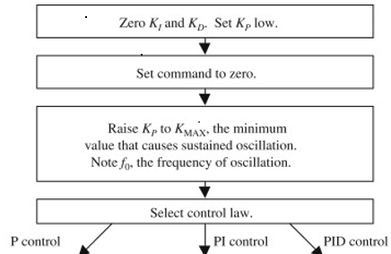
Ziegler – Nichols Tunning Method
 | K_{P} | K_{I} | K_{D}
P controller | 0.5 K_{MAX} | 0 | 0
PI controller | 0.45 K_{MAX} | 1.2 f₀ | 0
PID controller | 0.6 K_{MAX} | 2.0 f₀ | 0.125/f₀

Slide 11
Designing of Boost converter
Let us assume STCs i.e. 1000 W/m² & 25ºC
Worst condition i.e. 50 W/m² & 25ºC
PV array specifications:-
At 1000 W/m² & 25ºC :-
Vmp = 522 V, Pmpp = 165 kWp, Imp = 316.10 A
At 50 W/m² & 25ºC :-
Vmp = 90 % of Vmp at 1000 W/m² & 25ºC
= 0.9 * 522 = 469.80 V
Pmp = 5% of Pmp at 1000 W/m² & 25ºC
= 0.05 * 165 * 10³
= 8250W

Slide 12
Imp = Pmp / Vmp
= 8250 / 469.80
= 17.56 A
2. Switching frequency of boost converter = 25 kHz
3. Define current and voltage ripples specification
i .e. Δ V = 0.2 % of Vmpp & Δ I = 40 % of Impp
4. To calculate the internal resistance of PV array at MPP, Rmp = Vmp / Imp
At 1000 W/m² & 25ºC :- At 50 W/m² & 25ºC :-
Rmp = 522 / 316.1 Rmp = 469.80 / 17.56
= 1.6513 Ω = 26.754 Ω
5. Calculation of the load resistance (Ro)
Ro = 2.50 * Rmp at 50 W/m² & 25ºC
= 2.50 * 26.754
= 66.885 Ω

Slide 13

6. Calculate value of D at MPP :-
Dmp = 1 – $\sqrt{\frac{Rmp }{Ro}}$
At 1000 W/m² & 25ºC :-
Dmp = 1 –$\sqrt{\frac{ 1.6513 }{ 66.885}}$ = 0.84287
At 50 W/m² & 25ºC :-
Dmp = 1 – $\sqrt{\frac{26.754 }{66.885}}$ = 0.3675
7. Calculate values of Vo & Io :-
Vo = $\frac{VI }{( 1 – D )}$ & Io = $\frac{Vo }{Ro}$
At 1000 W/m² & 25ºC :- At 50 W/m² & 25ºC :-
Vo = 522 / ( 1 – 0.84287) Vo = 469.8 / ( 1 – 0.3675 )
= 3322.1 V = 742.7667 V
Io = 3322.1 / 66.885 Io = 742.7667 / 66.885
= 49.668 A = 11.105 A

Slide 14

8. Calculate ripple voltage and current i.e. Δ V and Δ I
Δ V_{I} = 0.002 * V_{I} = 0.002 * 522 = 1.044 V
Δ V_{o} = 0.002 * V_{o} = 0.002 * 3322.10 ( at 1000 W / m²) = 6.6442 V
Δ Io = 0.4 * 11.105 ( at 50 W / m²) = 4.442 A
9. Calculate reflected Input Resistence ( R_{IN} ) at i/p & PV array :-
R_{I} = Ro ( 1 – D² )
= 66.885 ( 1 – 0.84287² )
= 19.368 Ω
10. Put all calculated values in following equation and Calculate values of C_{IN} , Co And L :-
C_{I} = $\frac{4∗Vmp∗Dmp }{Δ VI ∗ RI∗fs}$
= $\frac{4 ∗ 522 ∗ 0.84287 }{1.044 ∗ 19.368∗25000}$
= 3500 µF (approx)

Slide 15

Co = $\frac{2 ∗ Vo ∗Dmp }{Δ Vo ∗Ro ∗ fs }$
= $\frac{2 ∗ 3322.1 ∗ 0.84287 }{6.6442 ∗ 66.885 ∗ 25000}$
= 510 µF (approx)
L = $\frac{Vmp ∗ Dmp}{2 ∗ Δ I ∗ fs}$
= $\frac{469.8 ∗ 0.3675}{2 ∗ 4.442 ∗25000}$
= 0.77736 mH
= 1 mH (approx)

Slide 16
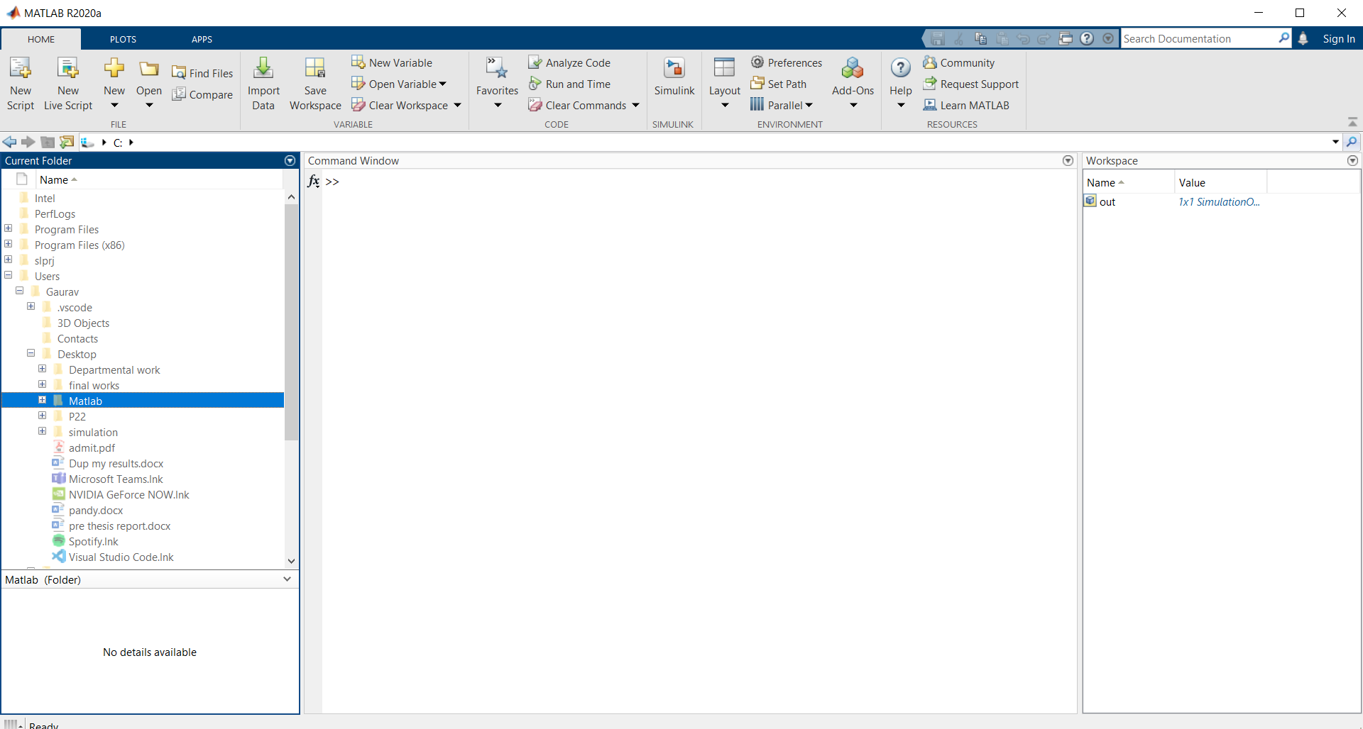
SOFTWARE & SIMULATION
MATLAB Software
MATLAB was invented by Dr. Cleve Moler (Mathematician and Computer Programmer).
This is the programming plateform designed for engineers and scientists to analyze and design systems and products.
We can do Analyze data, develop algorithms and Create models and applications with the MATLAB R2020a.
Now comes to MATLAB file extension for saving the SCRIPT we use “.m” and for SIMULINK we use “.slx”.

Slide 17
Simulation of Types of Controller
Simulation Process
Author in this sub chapter explains all about simulation process. Firstly, author designed the polar PV panel that is rating and all.
After that by using the 6.6 Sub – chapter that is designing of Boost converter, simulate the boost converter and integrate with solar PV panel.
Then, integrate the MPPT charge controller after designing and coding of MPPT algorithm which trigger the IGBT in such a way that we got maximum power output at that specified irradiance at that time.
Next, now author can integrate different controller that is P, PI, PID one by one in the forward path of MPPT.
Then after by using scope author generate the waveforms of different parameter and analyze according to their need.
Ratings of solar PV panels
Project for “Simulation of Controller for different Solar PV system” Solar PV having following specification :-
Module: - 1Soltech 1STH-215-P
Parallel Strings – 43
Series – connected modules per string – 18
Maximum output power per module – 213.35 W

Slide 18
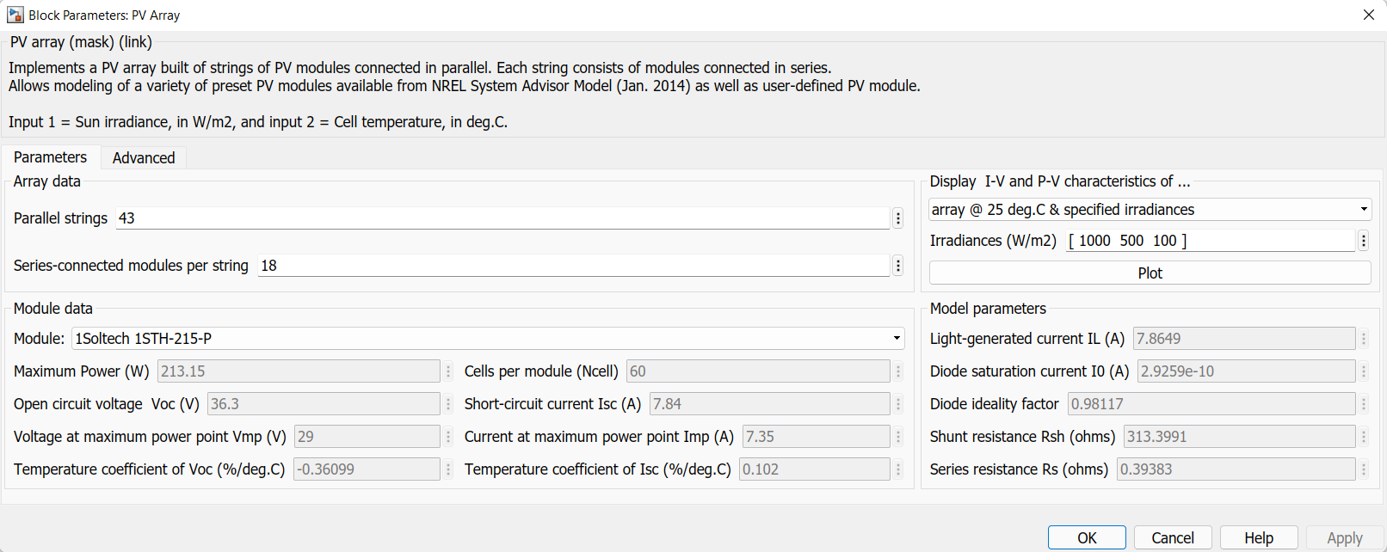

Slide 19
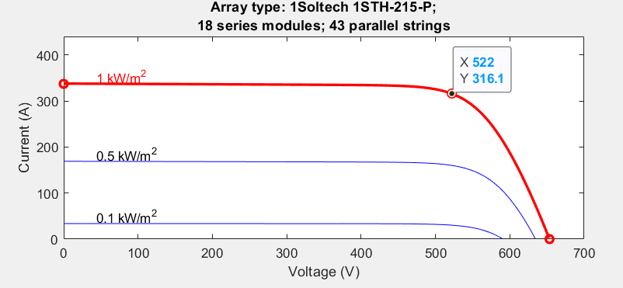
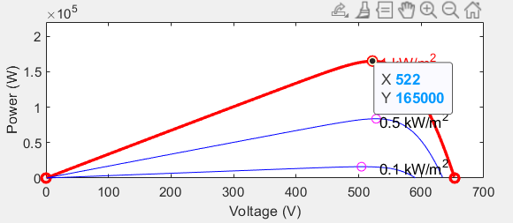
P-V and I- V characteristics of solar PV system generated by using MATLAB software.
Figure 7.3 is obtained for specified array temperature @25ºC with variable irradiance that is for 1000 W/m² , 500 W/m² and 100 W/m². By using these graph, we can measure the Power, Voltage and Current at Maximum point for extreme point that is @1000 W/m² and @50W/m² . This data is used for designing of Boost Converter in sub chapter 6.6.
These graph shows that at 1 KW/m² Irradiance,
maximum power given by solar PV is 165 kWp,
output PV voltage = 522V and
current deliver by PV = 316.1A.
It is also observed in P-V curve that when the irradiance increases from 0.1 to 1 kW/m­² , output of the panel also increases.

Slide 20
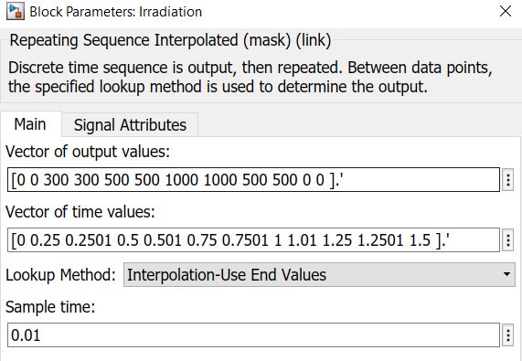
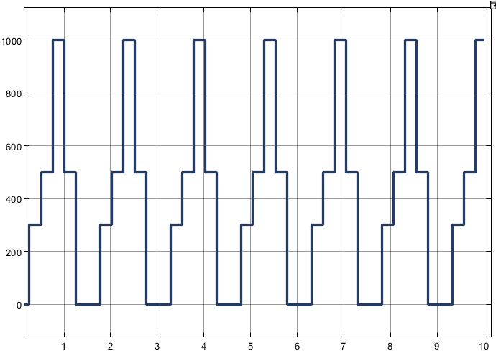
Type 1 Irradiation :-
Type 1 Irradiance similar to Cloudy day or Repetitive.

Slide 21
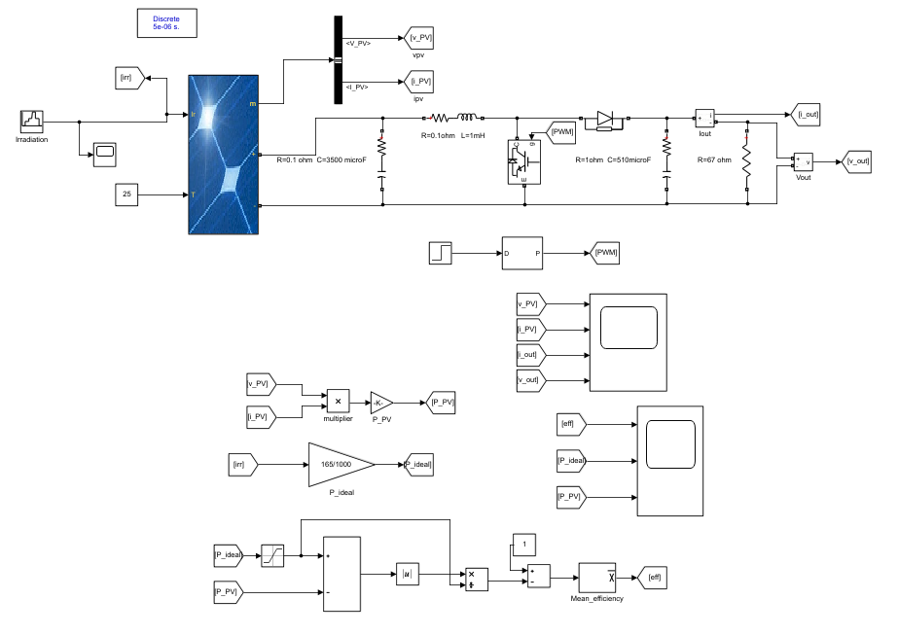
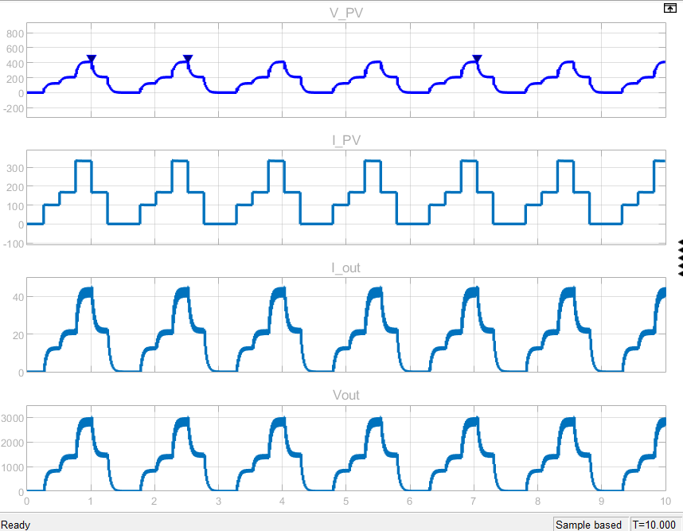
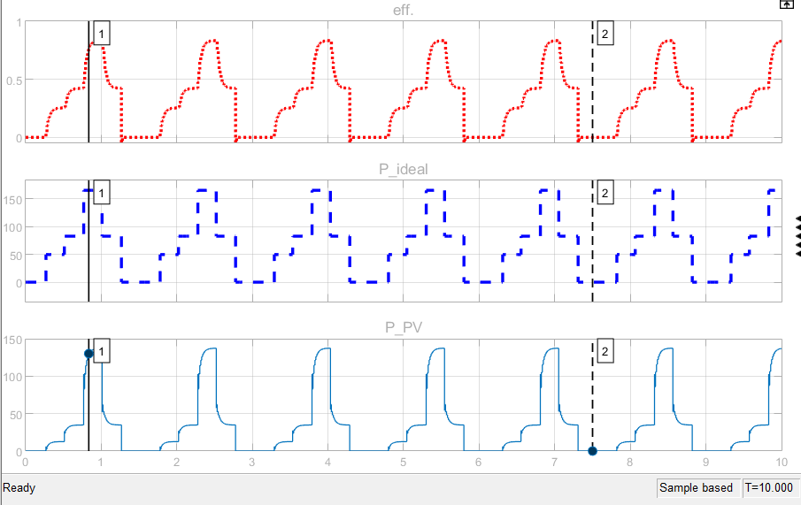
Boost Converter without MPPT controller

Slide 22
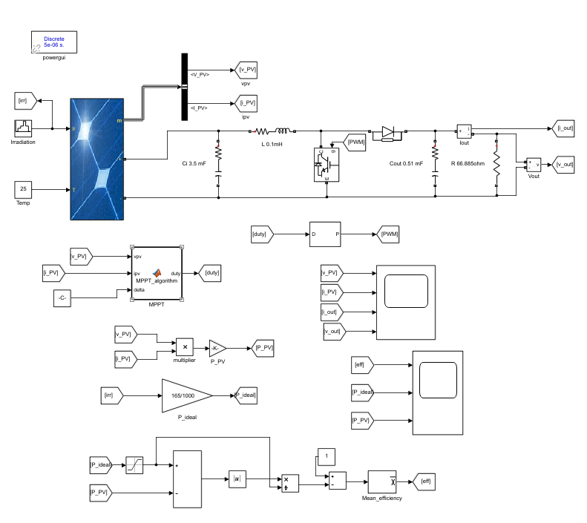
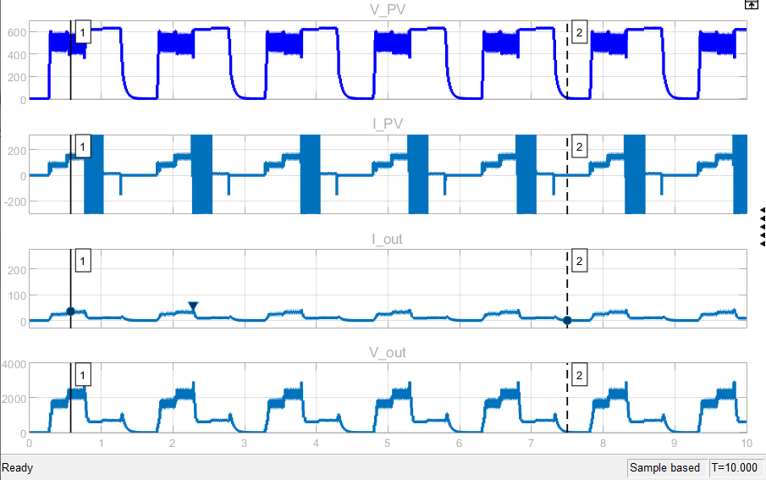
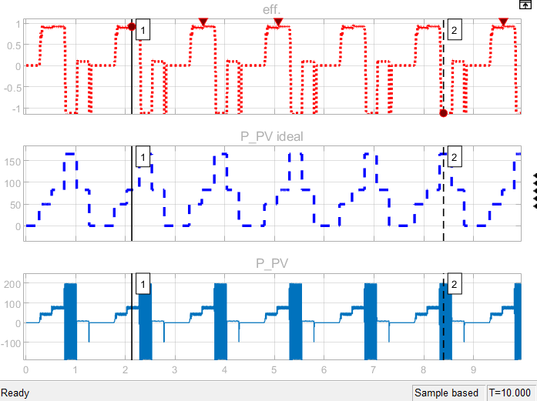
2. Boost Converter with MPPT Controller

Slide 23
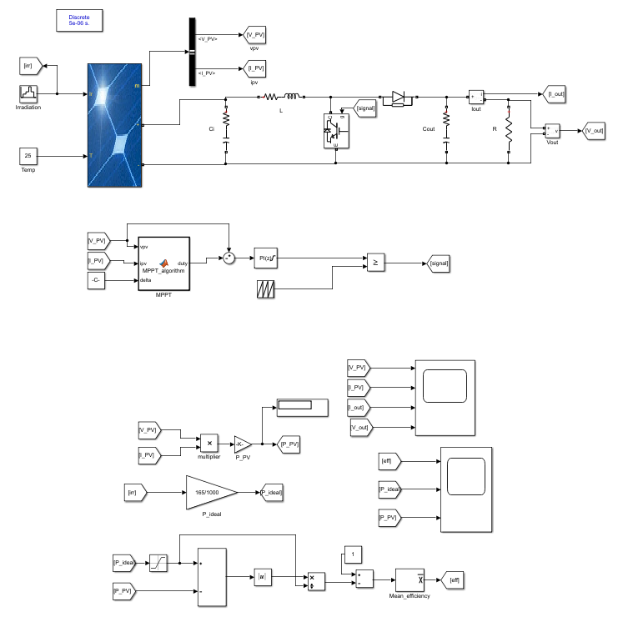
3. Boost Converter with MPPT with PI controller (without & with tunning)
PI controller at input side

Slide 24
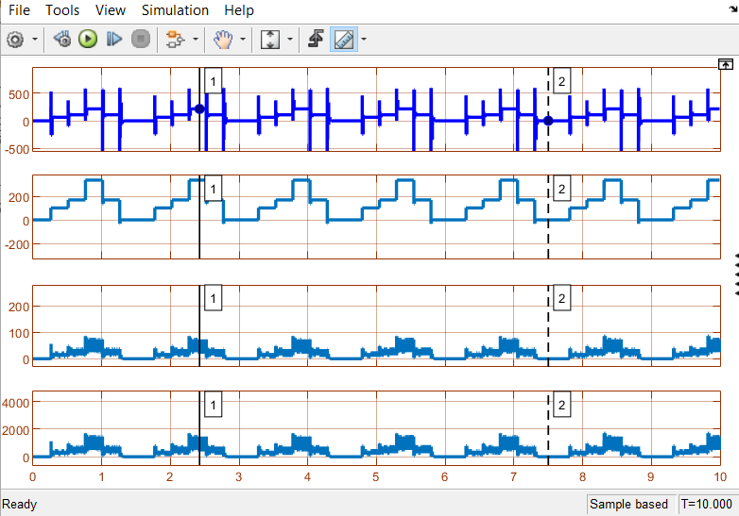
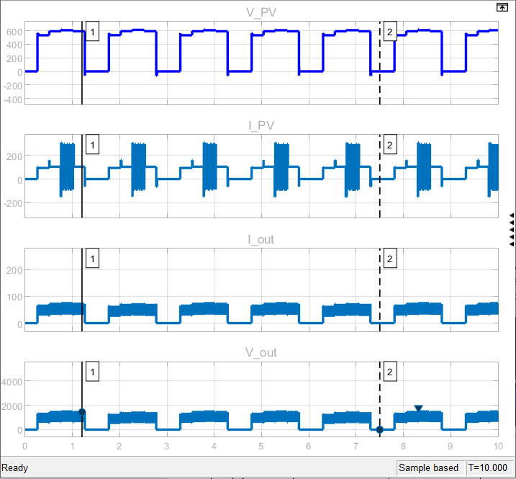
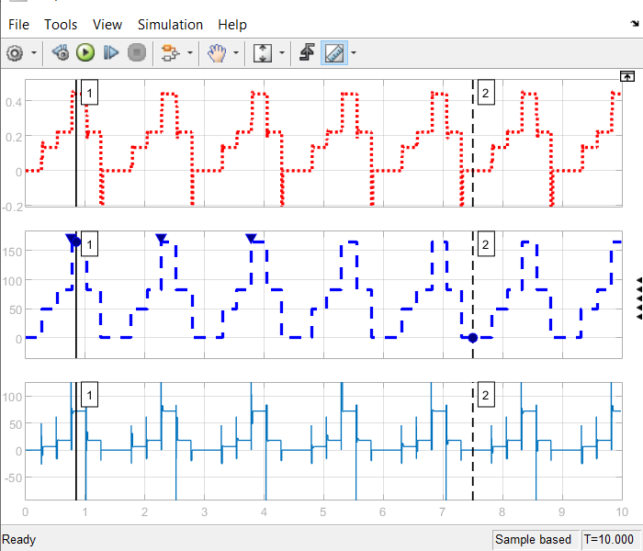
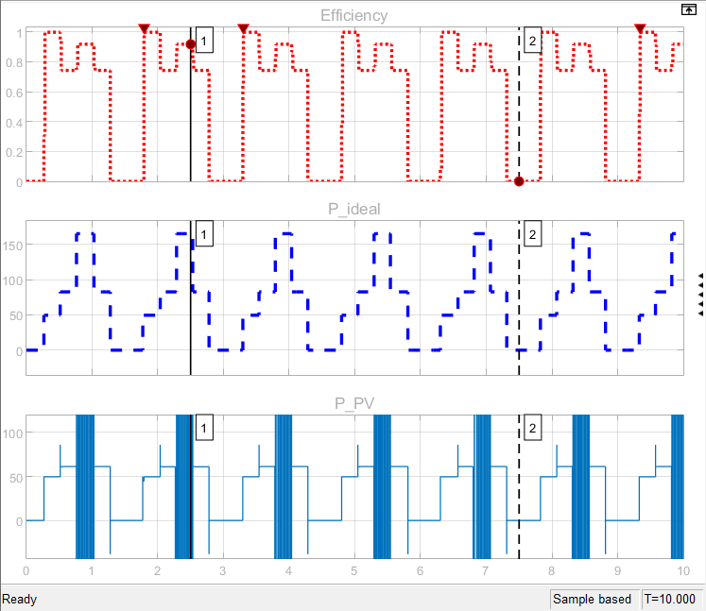
Without tunning where kp = 0.55 and ki = 1200 b) With tunning where Kp = 0.405 and ki = 4860

Slide 25
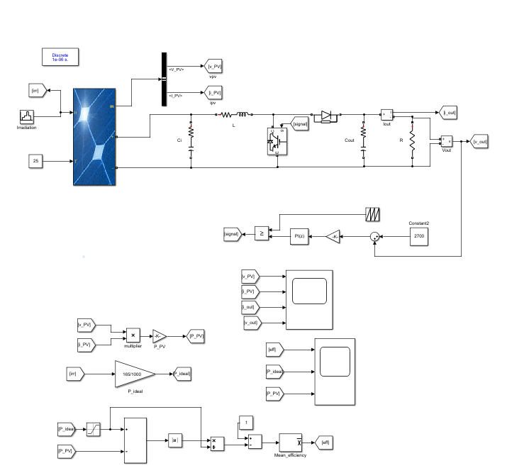
II. PI controller at output side

Slide 26
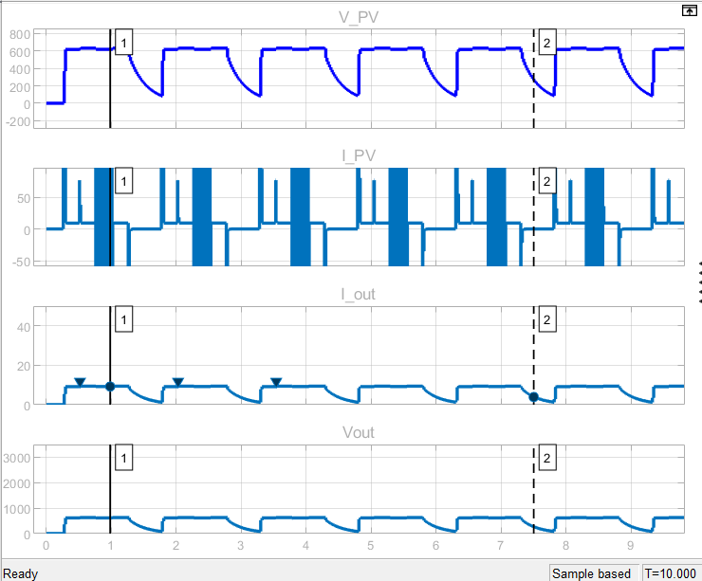
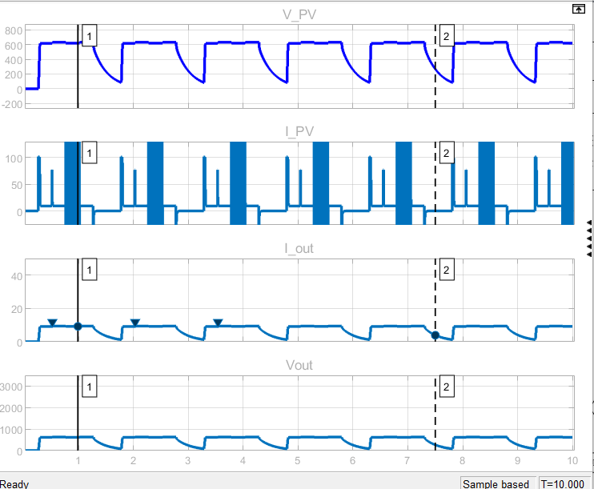
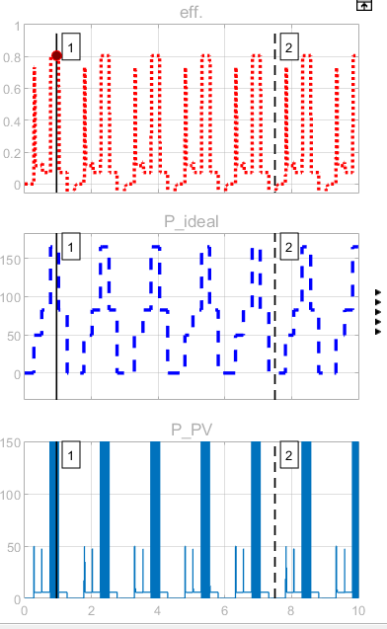
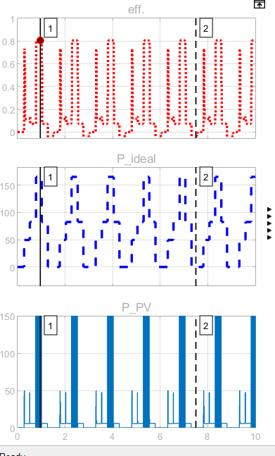
Without tunning with kp = 0.45 and ki = 54 b) With tunning with kp = 0.270 and ki = 6480

Slide 27
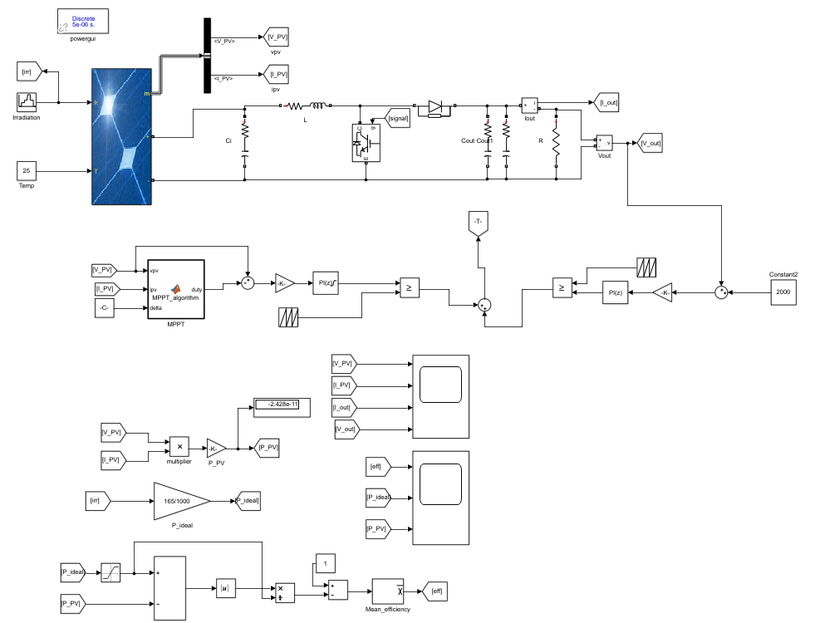
PI controller at input - output side

Slide 28
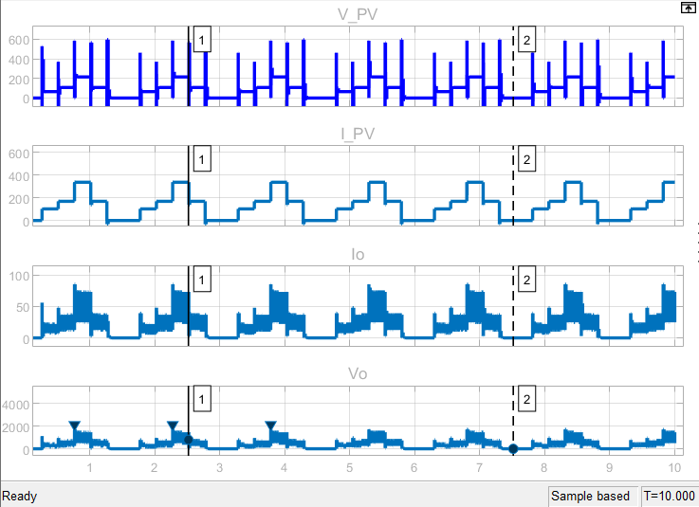
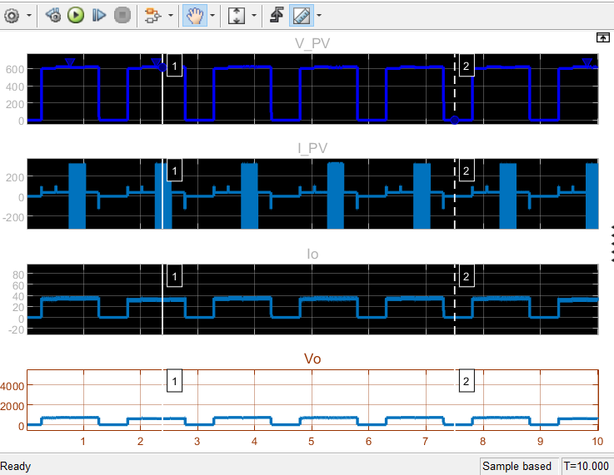
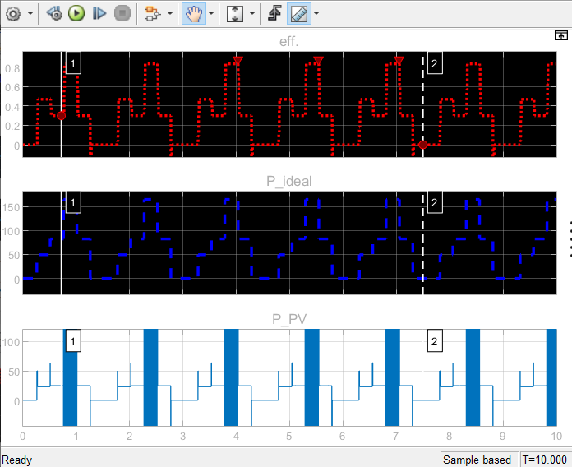
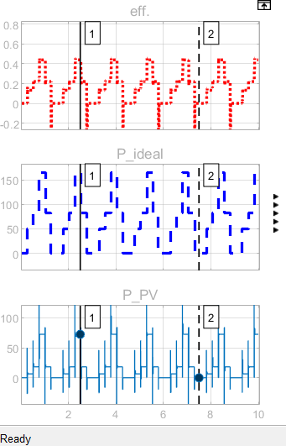
a) Without tunned at kp = 0.55 , ki = 1200 (input side) b) With tunned at kp = 0.8 , ki = 200000 (input side) &
& kp= 0.45 , ki = 54 (output side) kp= 0.2025 , ki = 243 (output side)

Slide 29
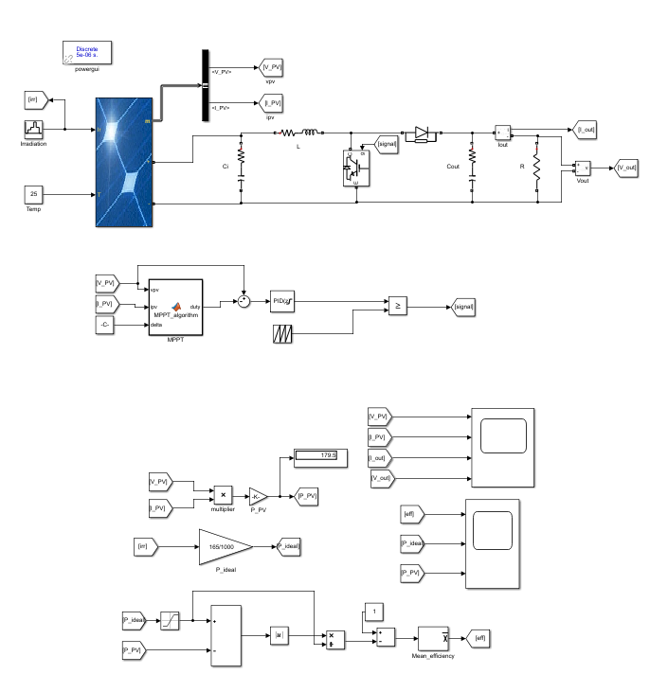
4. Boost Chopper with MPPT with PID controller (without or with tunning)
I. PID controller at input side

Slide 30
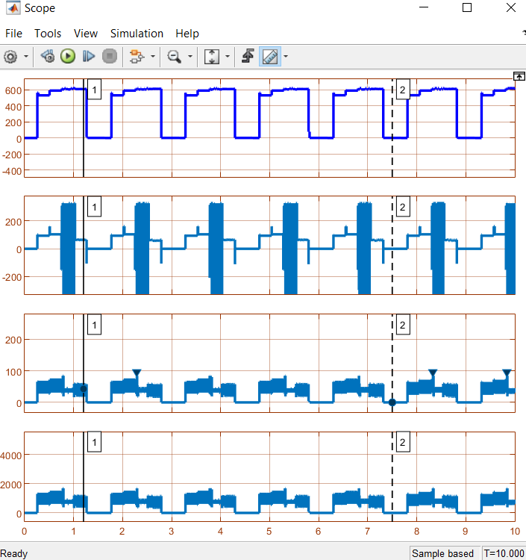
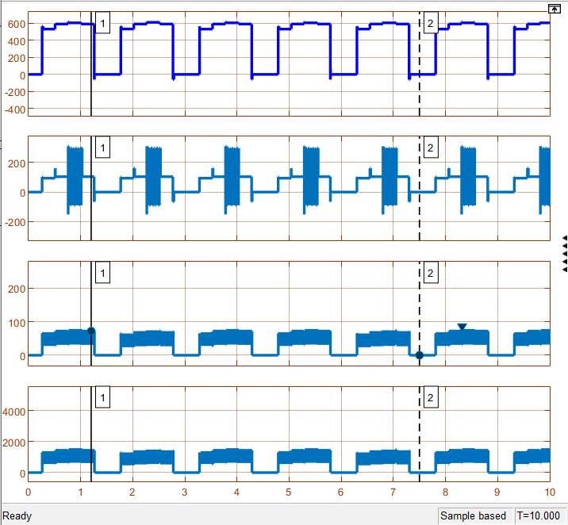
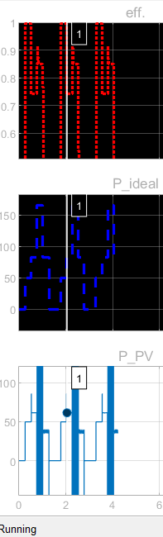
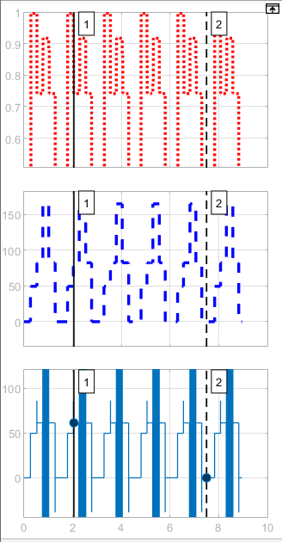
Waveforms when PID controller is b) Waveforms when PID controller is tunned with kp= 0.18,
Untunned with kp= 0.45 , ki = 0.01 & kd = 540 ki = 2000 & kd = 0.000125

Slide 31
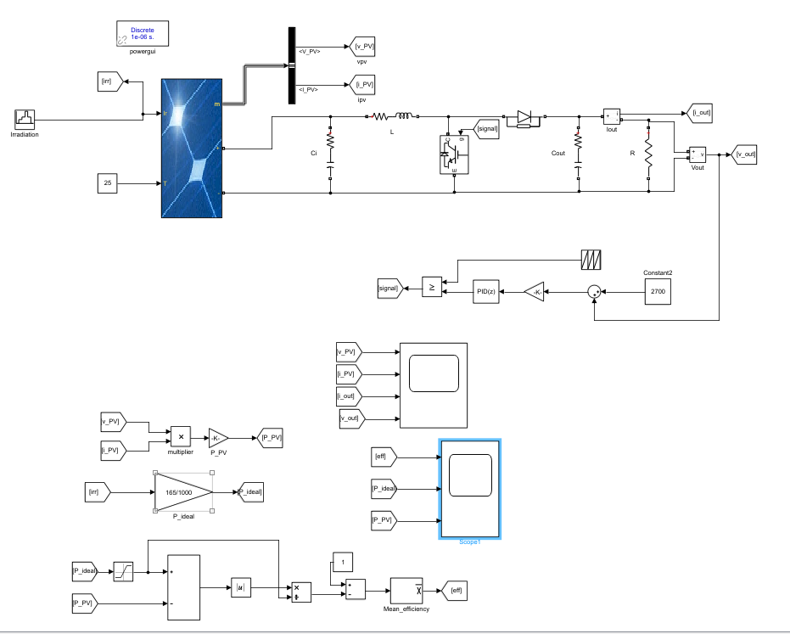
PID controller at output side

Slide 32
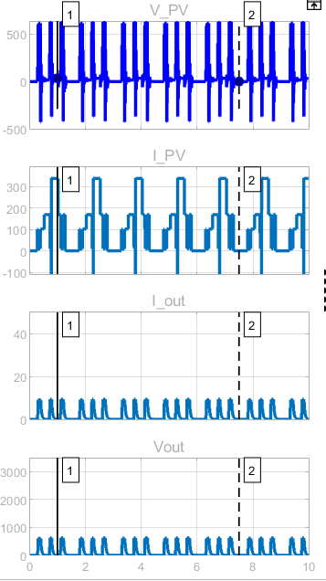
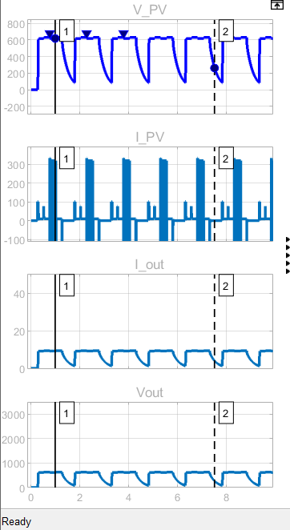
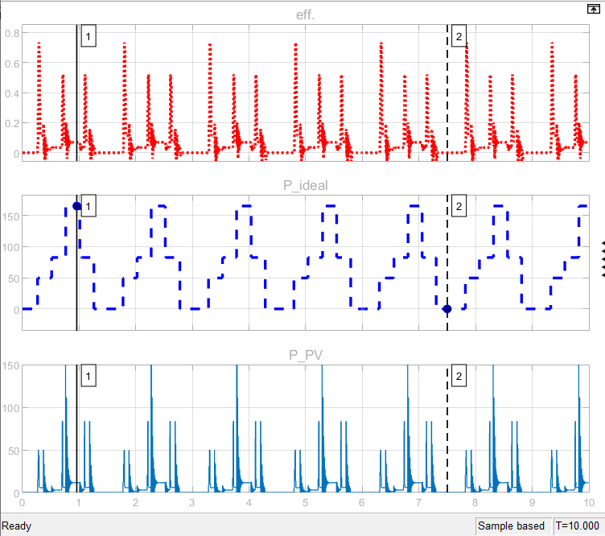
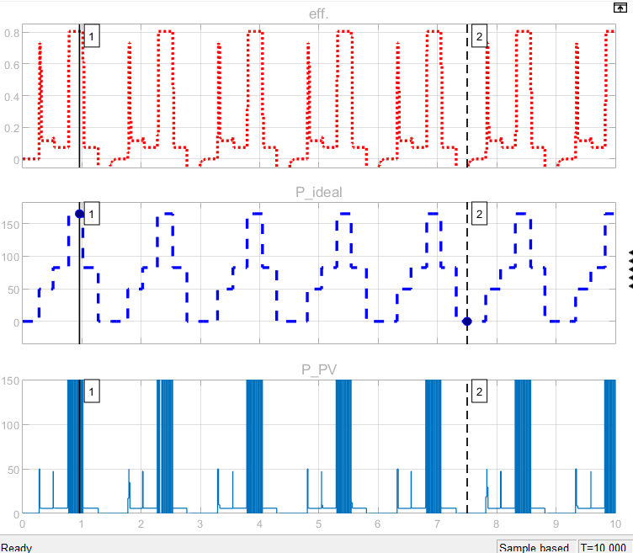
a) Without tunning kp = 0.45 , ki = 0.01 , kd = 540 b) With tunning kp = 0.3, ki = 600 , kd = 0.0000375

Slide 33
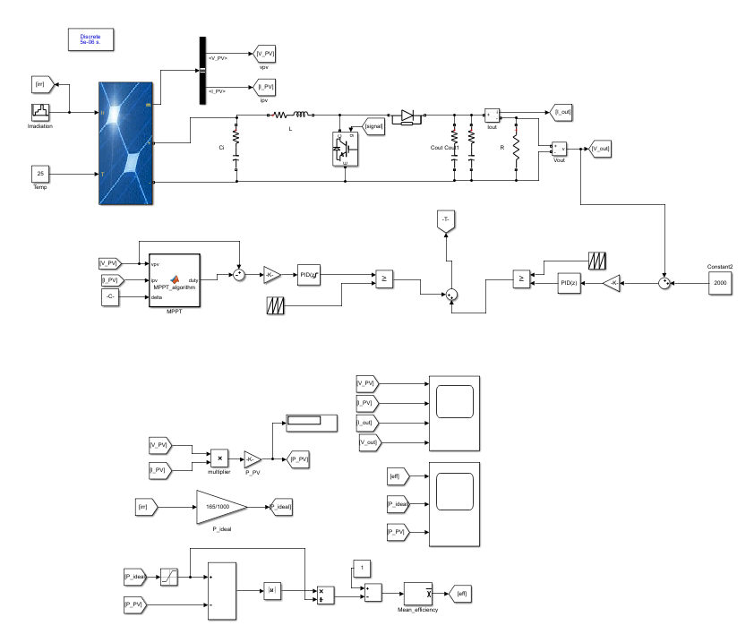
PID controller at input side and output side

Slide 34
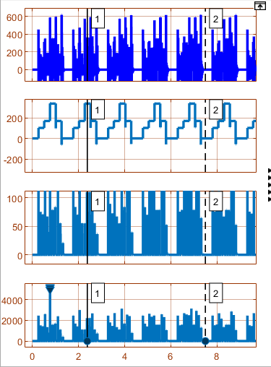
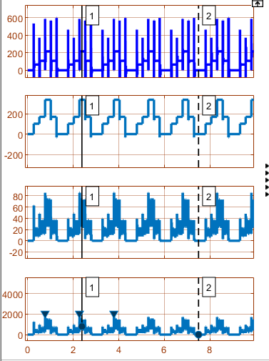
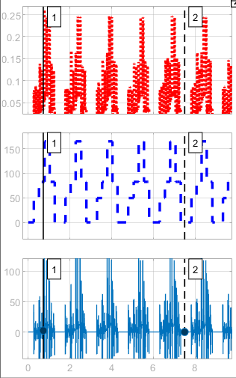
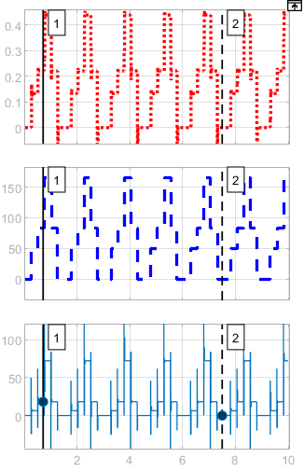
a) Without tunning kp = 0.45, ki = 0.01, kd= 54 (input side) b) With tunning kp = 0.54, ki = 1080, kd= 0.0000675 and kp = 0.45 , ki = 0.01 , Kd = 540 (output side) (input side) and kp = 0.48 , ki = 2000, kd= 0.000125
(output side)

Slide 35
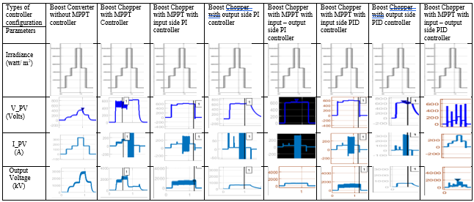
Observation Table:-
Comparative Study of tuned controllers for type 1 Irradiance (Repetitive) in terms of waveform.

Slide 36
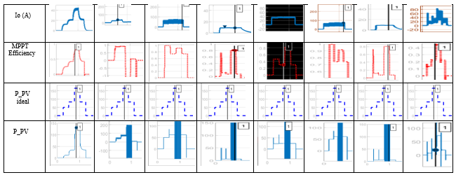

Slide 37
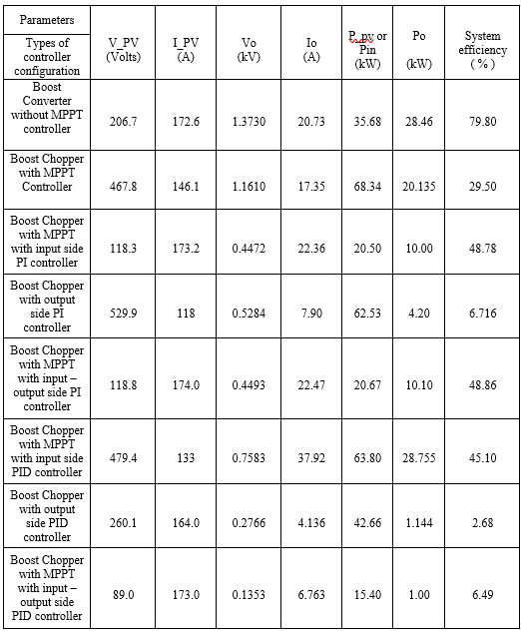
Comparative Study of untuned controllers for type 1 Irradiance in terms of numerical values of parameters.

Slide 38

Comparative Study of tuned controllers for type 1 Irradiance in terms of numerical values of parameters.

Slide 39


Type 2 Irradiance: Sunny days Irradiance that is continuous.

Slide 40

Comparative Study of tuned controllers for type 2 Irradiance (Continuous) in terms of waveform.

Slide 41


Slide 42

Comparative Study of tuned controllers for type 2 Irradiance in terms of numerical values of parameters.

Slide 43
Result:
For repetitive Irradiance or type 1 irradiance

Slide 48
Conclusion
The proposed model under the project demonstrated and encouraging performance in two aspects, which were finding the effectiveness of different controllers.
The finding of projects is the, one, tuned controller is highly effective than the untuned controller,
second, the efficiency of different controllers’ configuration is high for the continuous irradiance as compare to repetitive irradiance or equivalent to sunny days,
third, the harmonics of the boost converter with tuned controller is less as compare to untuned,
fourth, from all the controller’s configuration PI and PID controller at input side is high recommended for the solar PV system.
Fifth, the overall efficiency of the system is high for continuous irradiance. Finally, it is also found out that Ziegler Nichols algorithm is less effective for tunning and also lengthy process. So, from all the configuration of controller, input tuned PI controller is best for solar PV system.
Future Scope
There is lot of possibility to improve the efficiency of the controller to harness the maximum power from the solar PV using Generic algorithm (GA), Flower pollination algorithm (FPA), and many more. Also, author will concern about how to get optimized value of duty cycle of IGBT.

Slide 49
References
[1] B. K. Das, M. A. Alotaibi, P. Das, M. S. Islam, S. K. Das, and M. A. Hossain, “Feasibility and techno-economic analysis of stand-alone and grid-connected PV/Wind/Diesel/Batt hybrid energy system: A case study,” Energy Strateg. Rev., vol. 37, no. December 2020, p. 100673, 2021, doi: 10.1016/j.esr.2021.100673.
[2] C. Ceylan and Y. Devrim, “Design and simulation of the PV/PEM fuel cell based hybrid energy system using MATLAB/Simulink for greenhouse application,” Int. J. Hydrogen Energy, vol. 46, no. 42, pp. 22092–22106, 2021, doi: 10.1016/j.ijhydene.2021.04.034.
[3] D. Toumi et al., “Optimal design and analysis of DC–DC converter with maximum power controller for stand-alone PV system,” Energy Reports, vol. 7, pp. 4951–4960, 2021, doi: 10.1016/j.egyr.2021.07.040.
[4] L. Fara and D. Craciunescu, “Output Analysis of Stand-alone PV Systems: Modeling, Simulation and Control,” Energy Procedia, vol. 112, no. October 2016, pp. 595–605, 2017, doi: 10.1016/j.egypro.2017.03.1125.
[5] M. Bhavani, K. Vijaybhaskar Reddy, K. Mahesh, and S. Saravanan, “Impact of variation of solar irradiance and temperature on the inverter output for grid connected photo voltaic (PV) system at different climate conditions,” Mater. Today Proc., no. xxxx, 2021, doi: 10.1016/j.matpr.2021.06.120.
[6] National grid Report (2015)
[7] M. Lokeshreddy, P. J. R. P. Kumar, S. A. M. Chandra, T. S. Babu, and N. Rajasekar, “Comparative study on charge controller techniques for solar PV system,” Energy Procedia, vol. 117, pp. 1070–1077, 2017, doi: 10.1016/j.egypro.2017.05.230.
[8] A. Alhejji and M. I. Mosaad, “Performance enhancement of grid-connected PV systems using adaptive reference PI controller,” Ain Shams Eng. J., vol. 12, no. 1, pp. 541–554, 2021, doi: 10.1016/j.asej.2020.08.006.
[9] H. A. Abd el-Ghany, A. E. ELGebaly, and I. B. M. Taha, “A new monitoring technique for fault detection and classification in PV systems based on rate of change of voltage-current trajectory,” Int. J. Electr. Power Energy Syst., vol. 133, no. January, p. 107248, 2021, doi: 10.1016/j.ijepes.2021.107248.
[10] S. Silvestre, M. A. Da Silva, A. Chouder, D. Guasch, and E. Karatepe, “New procedure for fault detection in grid connected PV systems based on the evaluation of current and voltage indicators,” Energy Convers. Manag., vol. 86, pp. 241–249, 2014, doi: 10.1016/j.enconman.2014.05.008.

Slide 50
THANK YOU

Slide 53


P&O Algorithm of MPPT Charge Controller for extraction of maximum power from the solar PV system.

